Slide 1
Foundations of Large Language Models: Tools, Techniques, and Applications
Notes:
Note for instructor: please ensure you check the accessibility of your own slides before you deliver your presentation: https://uwaterloo.ca/centre-for-teaching-excellence/accessibility-checklist-ms-powerpoint

Slide 2
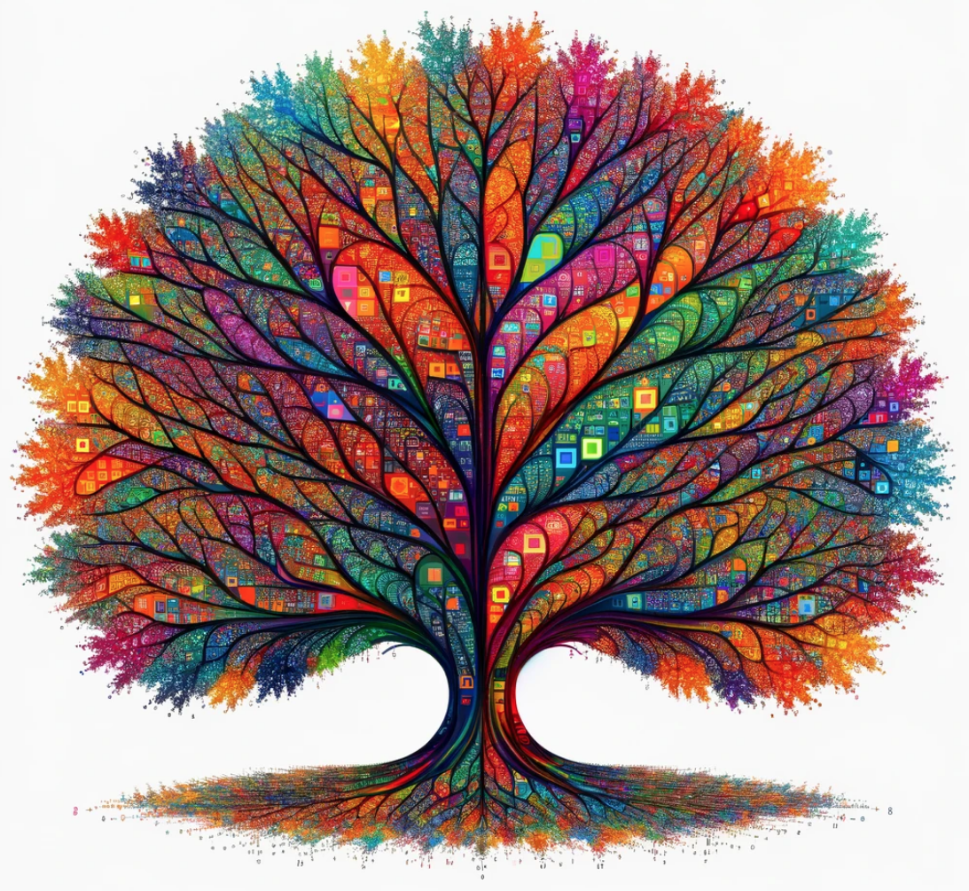
Foundations of Large Language Models: Tools, Techniques, and Applications
(3rd edition)
Instructor: Brian Zimmerman
Photo source: Bing Image Creator

Slide 3
Required Tools for the Course
Google Colab Pro
CAD 13.99 per month
https://colab.research.google.com/signup
OpenAI Account with an API key
Purchase $5 in credit for Level 1 status
Expenditures shouldn’t exceed $10 for the course

Slide 4
Overview of Today – Module 1
Review of NLP Tasks
Lifecycle of LLMs
Open Source LLMs (LLaMA-2, Mistral)
If we have time
Brief History of NLP
Types of Embeddings

Slide 5
What is NLP?
Language
Algorithm
Insights
Product
Review
Algorithm
Positive or Negative
Code snippet
Algorithm
Comments
Text in French
Algorithm
English Translation

Slide 6

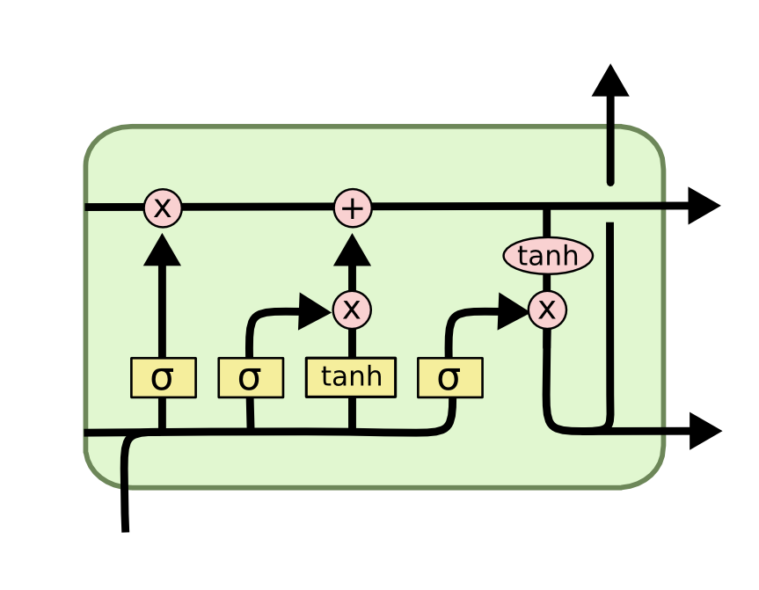
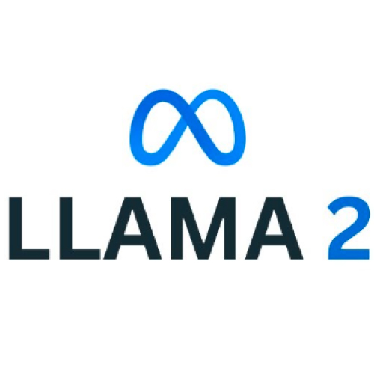



What is an NLP algorithm?
Human readers
Neural Networks
“Large Language Models”
In 2024
Scientists

Slide 7
Lifecycle of LLMs
Two stage procedure:
Self-supervised pre-training (90% of cost)
Fine-tuning on a task

Slide 8
Lifecycle of LLMs
Examples of fine-tuning tasks:
Adding instructions into prompts (instruction tuning)
Training new task-specific parameters (adapters)

Slide 9

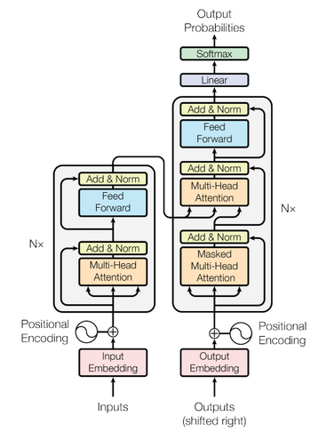
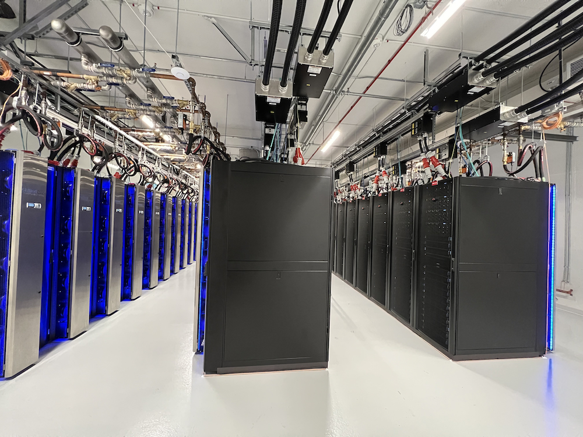

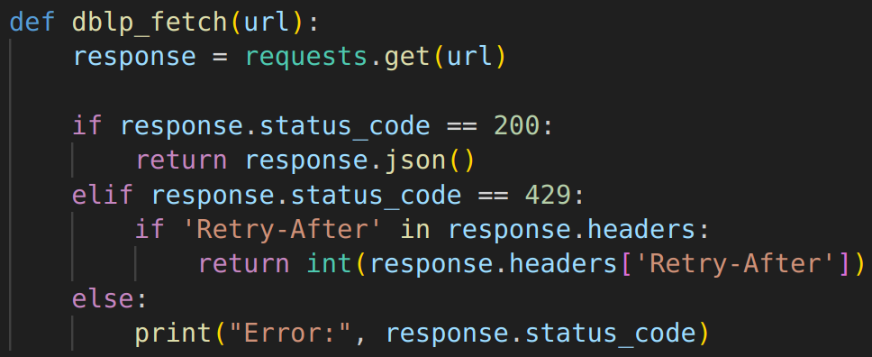

Lifecycle of LLMs – Self-supervised Pre-training
Wikipedia
Books
Code Snippets
Compute clusters with GPUs
Social Media
Model with 1 billion+ parameters

Slide 10
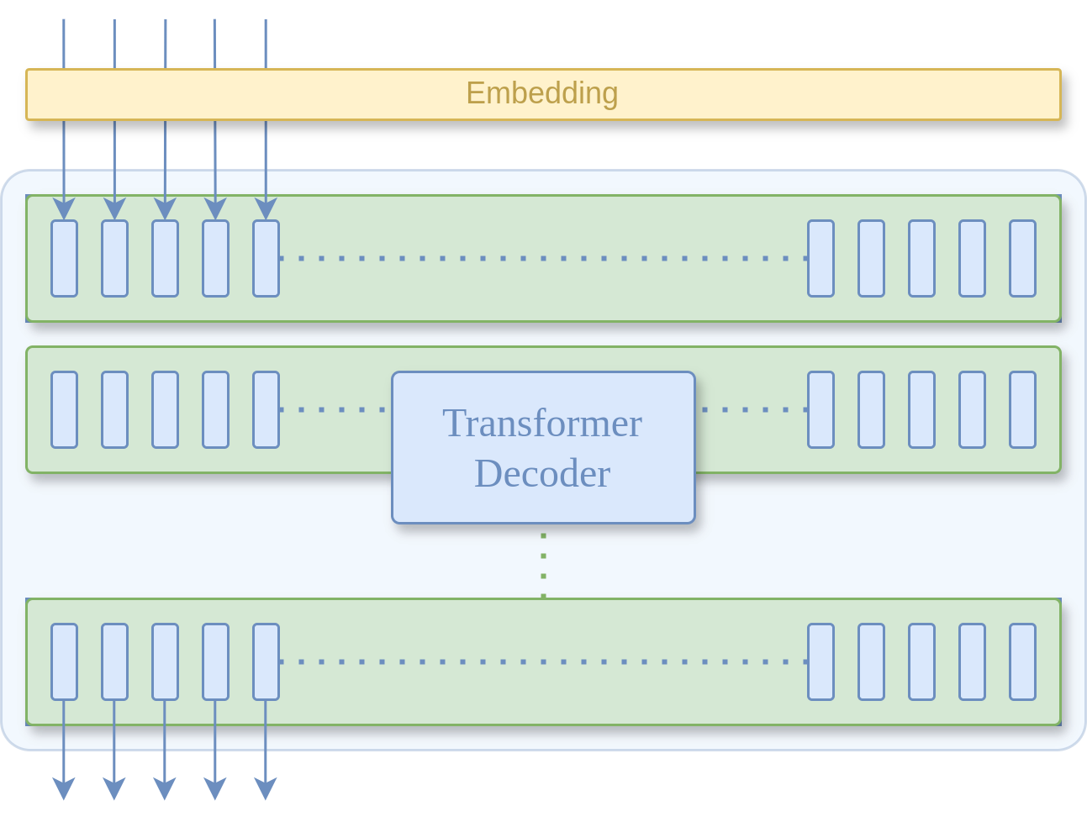
Lifecycle of LLMs – Self-supervised Pre-training
The
the
dog
runs
around
yard
park
tree
large
apple
the
Softmax function
The dog runs around the yard
dog
the
runs
around

Slide 11
Lifecycle of LLMs – Self-supervised Pre-training
yard
P(“yard” | “The dog runs around the”)
park
tree
large
eg. The probability of the token “yard” being next, given the sequence “The dog runs around the”
apple
the
Cross-Entropy Loss is used as a training objective to maximize this likelihood as we train the LLM.
Softmax function

Slide 12
Lifecycle of LLMs – Inference
How do we generate new texts during inference?

Slide 13
Lifecycle of LLMs – Inference
capybara
sample from the produced distribution to select the next input token
The
dog
cat
capybara
pizza
extra
a
Softmax function

Slide 14
Utility of LLMs
Most NLP tasks can be described as text generation tasks
Summarization
Autocompletion
Translation
Question answering
Dialogue
Information extraction
Named entity recognition
Coreference Resolution
Code generation
Text Evaluation
Many more!

Slide 15
Example – Few-shot Document Classification
Example 1:
This document is a financial statement that reports a company's financial performance over a specific period of time. It shows the company's revenues, expenses, and profits.
Class: Income Statement
Example 2:
This document shows a company's assets, liabilities, and equity at a specific point in time.
Class: Balance Sheet
Example 3:
This document shows the inflow and outflow of cash and cash equivalents of a company during a specific period of time.
Class: Cash Flow Statement
Example 4:
This document shows the changes in the equity of a company during a specific period of time.
Class: Statement of Equity
Example 5:
This document shows the sources and uses of a company's financing during a specific period of time.
Class: Statement of Financing
Example 6: {document text}
Class: {the model will generate the answer here}
Giving the model examples “in context” to motivate it to perform the task we want completed. [Example]

Slide 16
Notebook – Using GPT-3.5-turbo for sentence classification
Google Colab Link

Slide 17
Open Source LLMs
Pre-trained LLMs (LLaMA-2, Mistral 7b) with their parameters freely available online.
Benefits:
No per-token charge
Privacy and Security
Full control for users
Can be run on premises

Slide 18
Open Source LLMs – LLaMA-2
Released by Meta
Comes in a variety of sizes
7b, 13b, and 70b
Trained on 2 trillion tokens
70b parameter model is similar to GPT-3.5-turbo
Available for commercial use

Slide 19
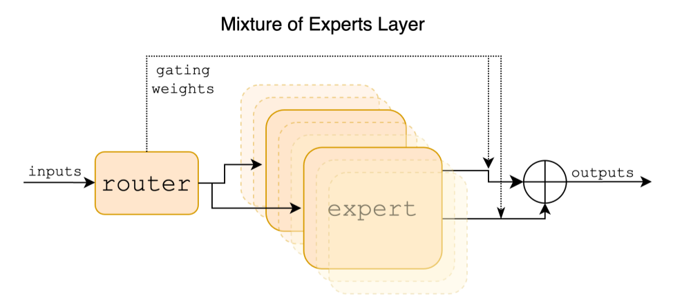
Open Source LLMs – Mistral-7b
Released by Mistral AI
7 billion parameters
“Sparse mixture of experts” model
Trained on 8 trillion tokens
Can be run on Colab with only 16G vram

Slide 20
Notebook – Using Mistral-7B for zero-shot sentence classification
Google Colab Link

Slide 21
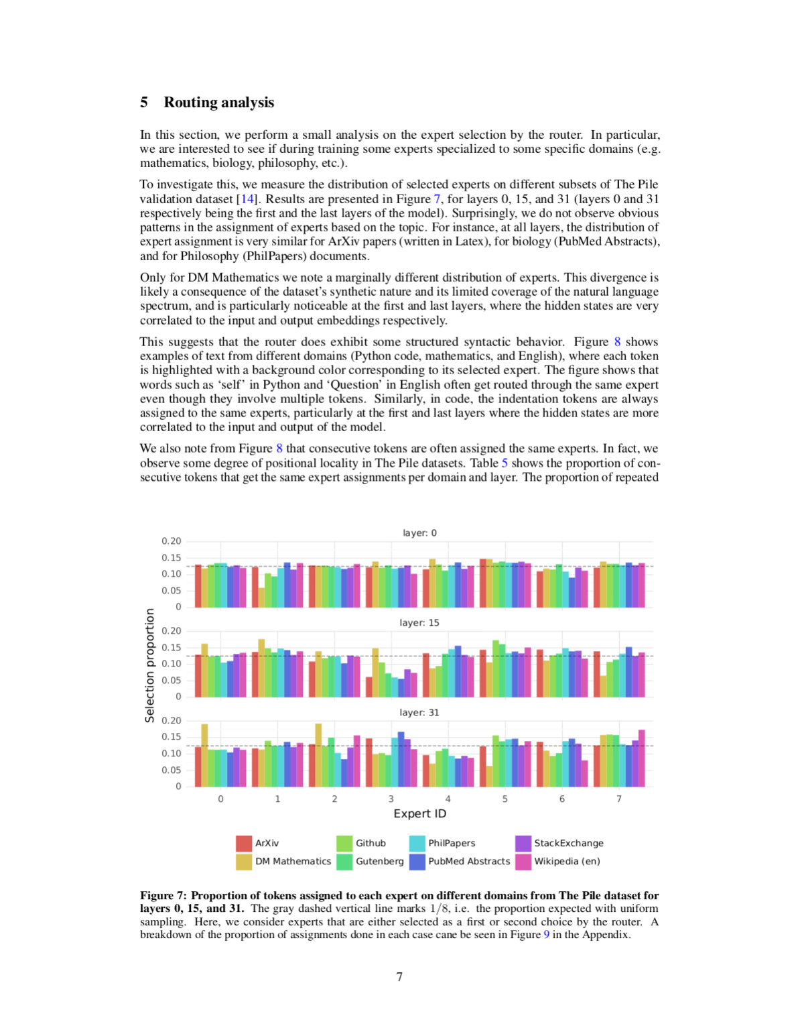
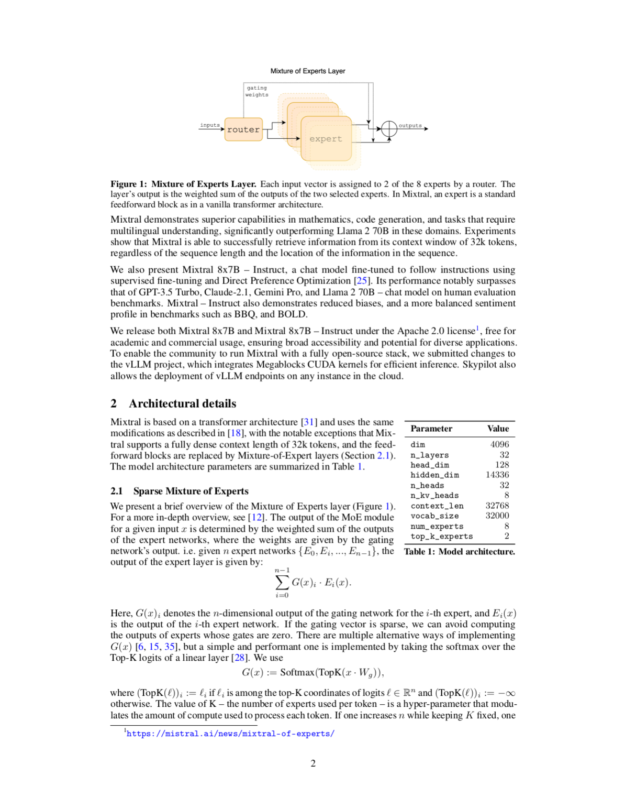
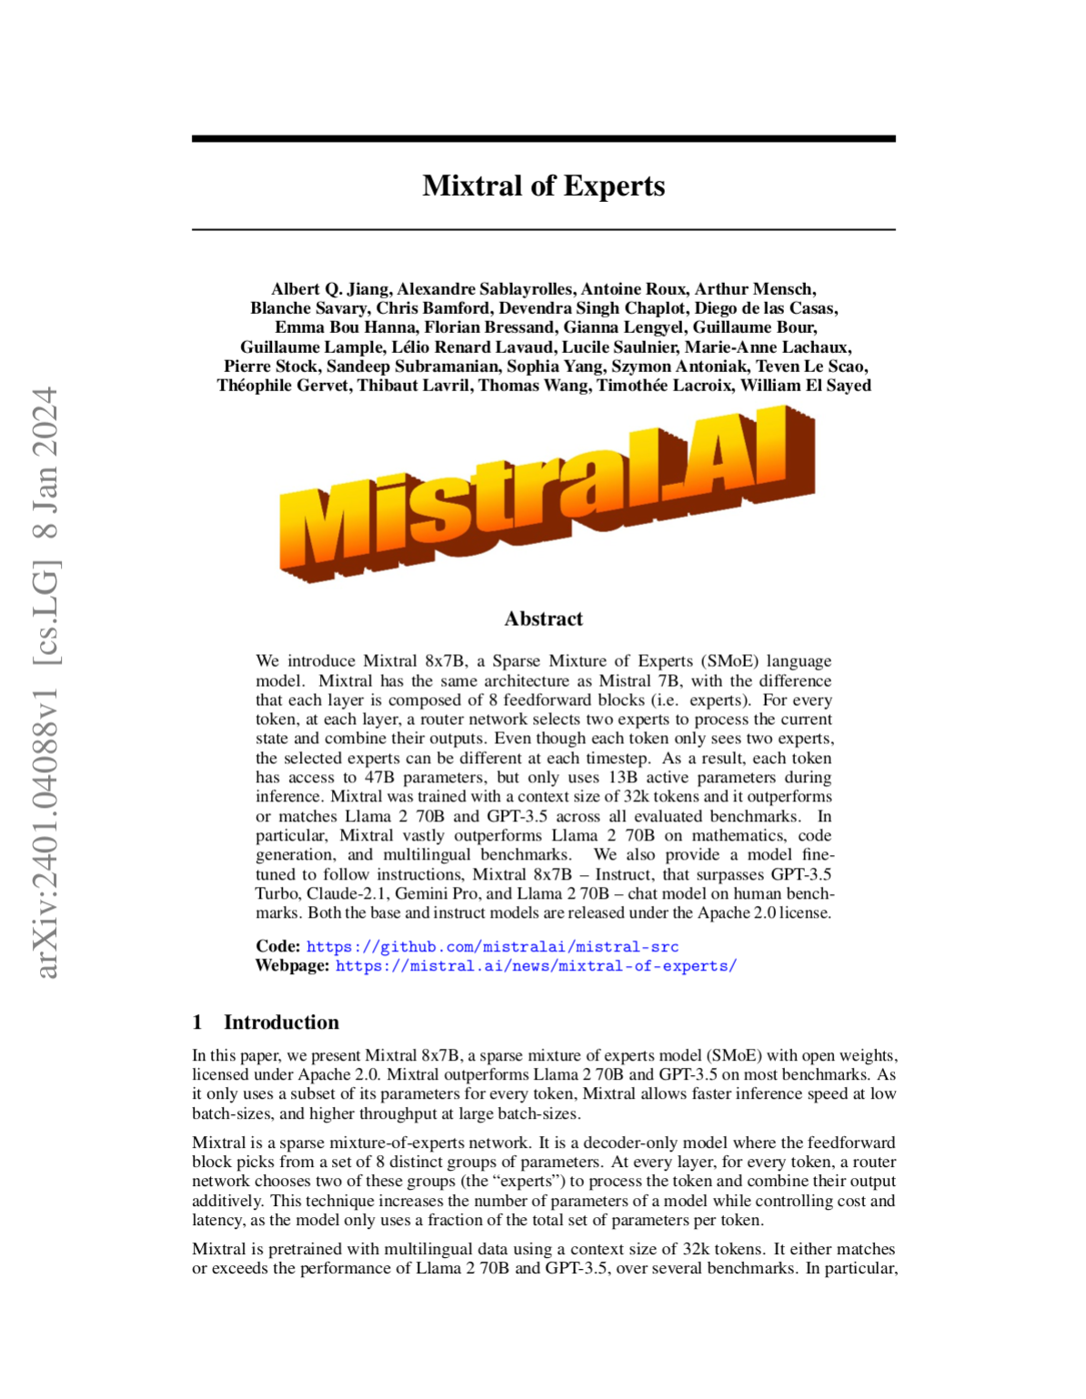
Fine-tuning on Instructions
Zero shot input: Instruction + paper contents without abstract, introduction, or conclusion [Link]
Summarize the following text.
Text:
Mixtral is based on a transformer architecture [31] and uses the same modifications as described in [18], with the notable exceptions that Mix- tral supports a fully dense context length of 32k tokens, and the feed- forward blocks are replaced by Mixture-of-Expert layers (Section 2.1).
…
For example, cases with high locality are more likely to cause over-subscription of certain experts when doing Expert Parallelism. Conversely, this locality can be leveraged for caching, as is done in [11]. A more complete view of these same expert frequency is provided for all layers and across datasets in Figure 10 in the Appendix.
Summary:
The text discusses the Mixtral model, which is based on a transformer architecture and utilizes a sparse mixture of experts approach. Mixtral outperforms other models on various benchmarks, including multilingual tasks and bias assessments. The model is efficient, using fewer parameters per token compared to other models like Llama 2. Mixtral also introduces Mixtral - Instruct, a chat model that surpasses other existing models. The text details the model's architecture, performance comparisons, fine-tuning methods, expert selection analysis, and implications for training and inference optimization.

Slide 22
Fine-tuning Procedure
Assemble a dataset of instruction/output pairs
Identify a suitable pre-trained model
Continue training the model on your curated dataset
Input
Summarize the report: Salamander Corp is a market leader…
Target
This report describes expenditures for Salamander Corp in Q3 2023 and their justifications.

Slide 23
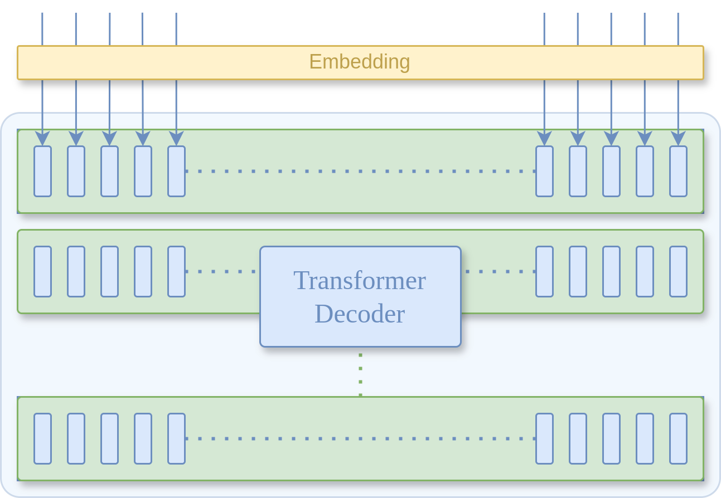
Fine-tuning Procedure
Input (Task + Text)
Target (Expected result)
Salamander
justifications
2023
.
and
Summarize
their
this
report
:
The model can be any pre-trained transformer decoder (eg. Mistral-7b)

Slide 24
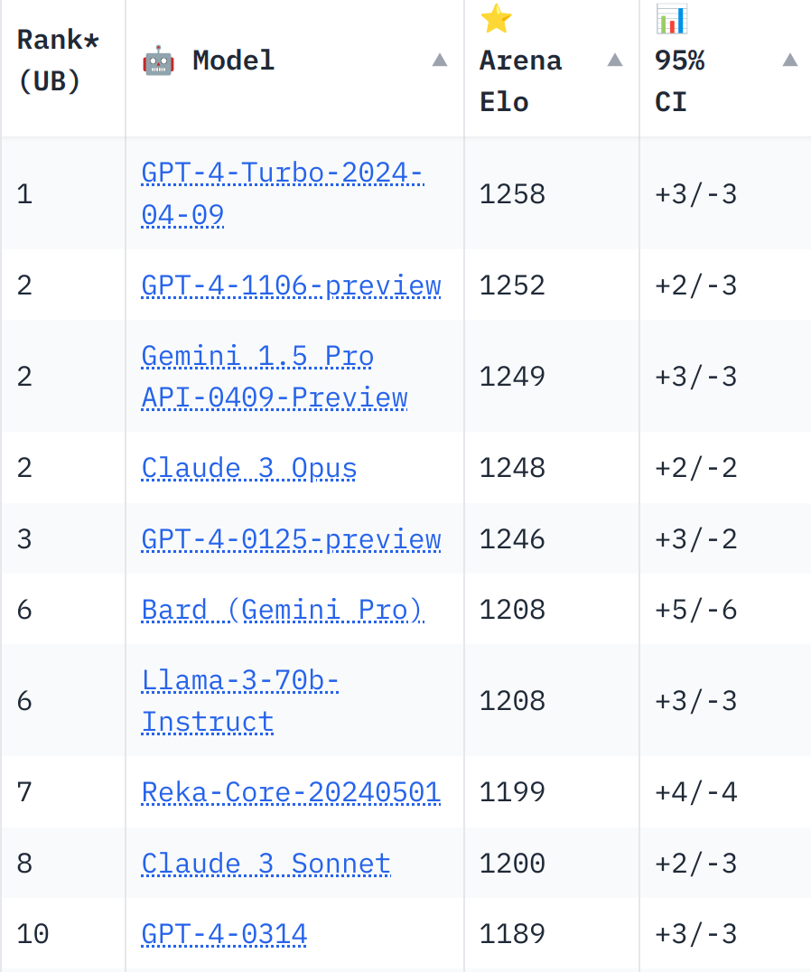
Selecting a Model for Fine-tuning
Online initiatives to evaluate LLMs against one another such as Chat Arena Leaderboard are useful for getting started.

Slide 25
Module 1 Lab Assignment
Using Mistral-7b for few-shot sentence classification
Google Colab Link

Slide 26
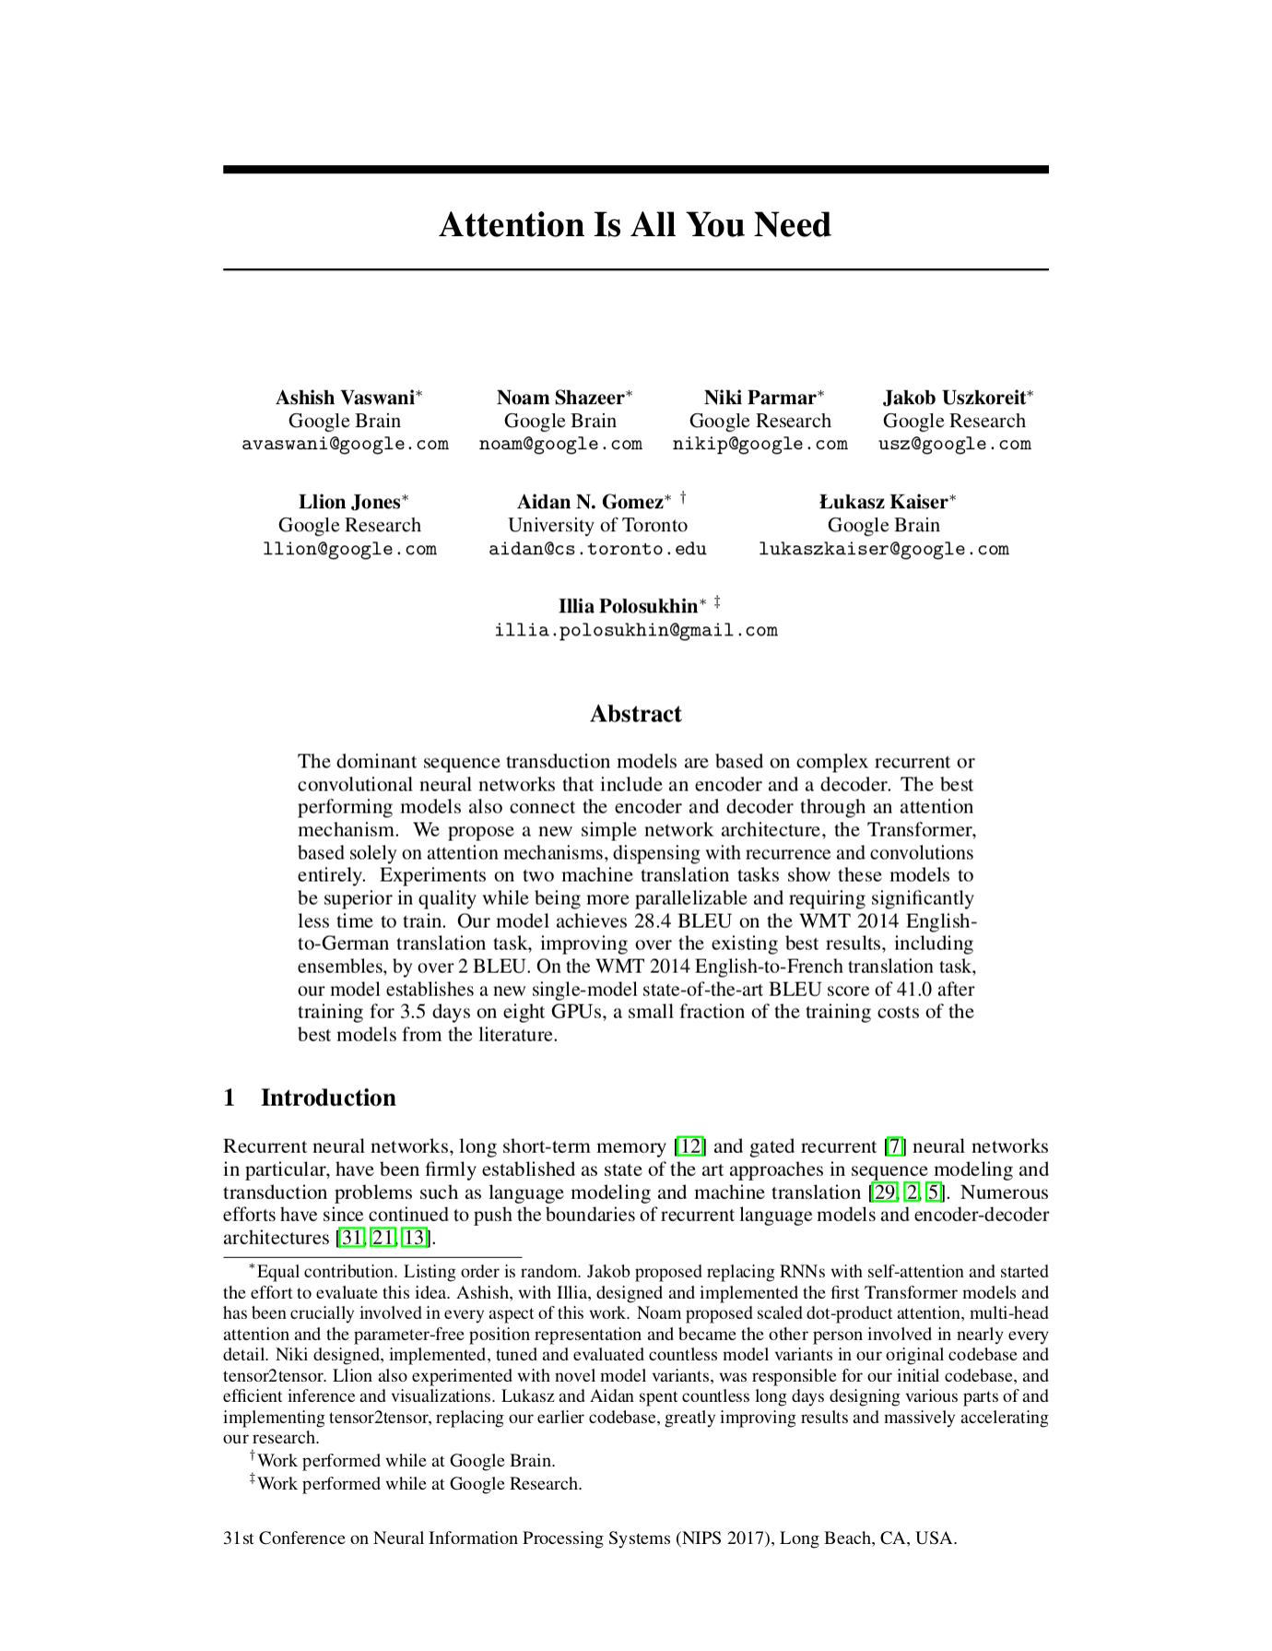
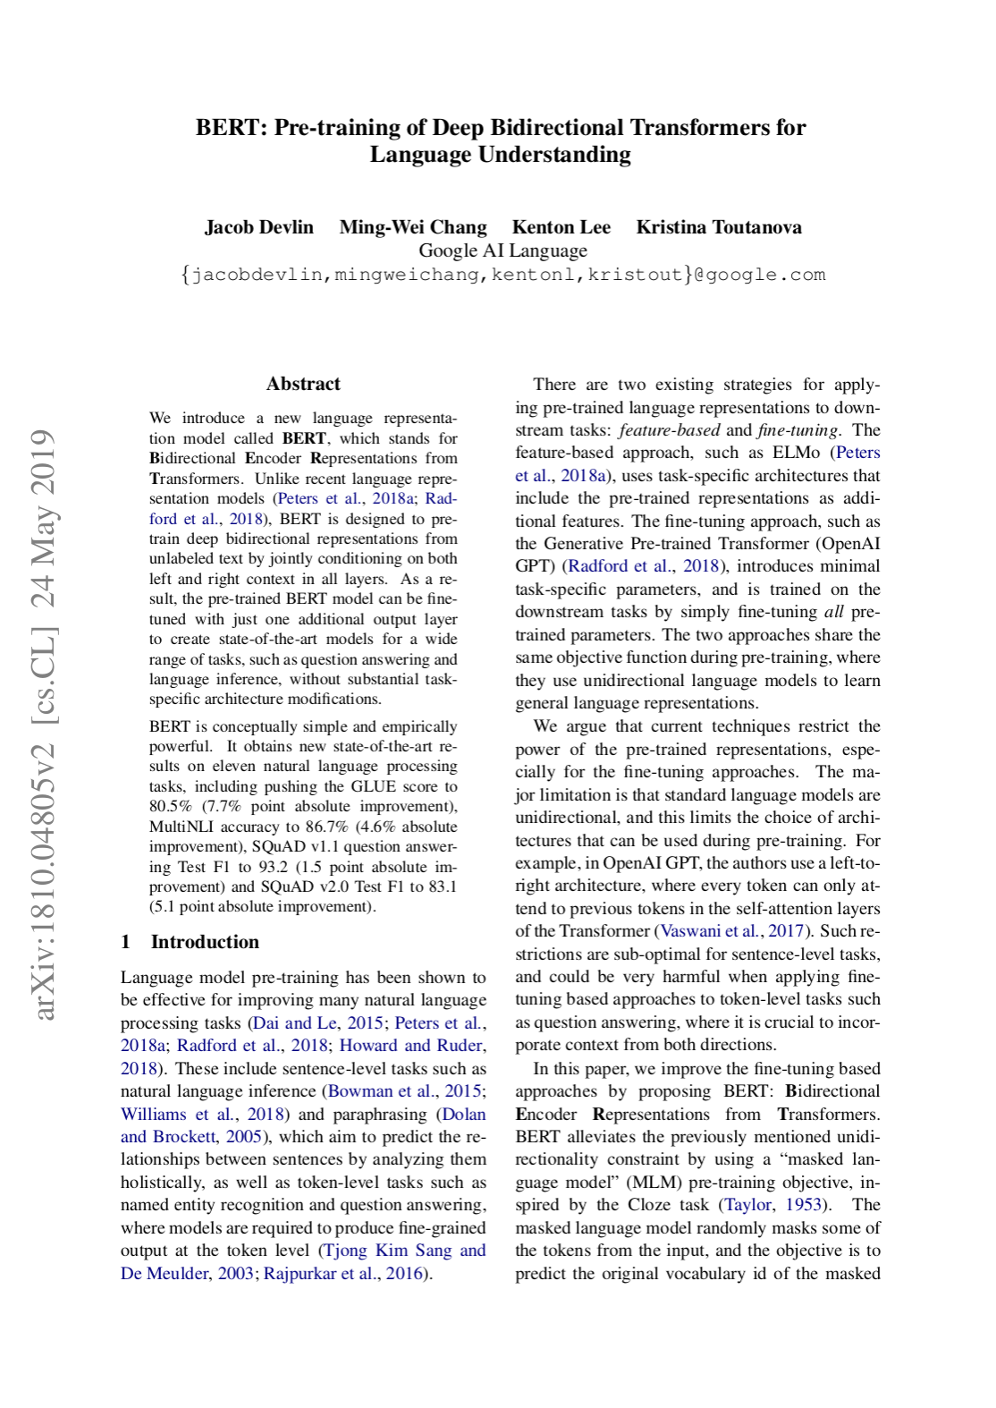
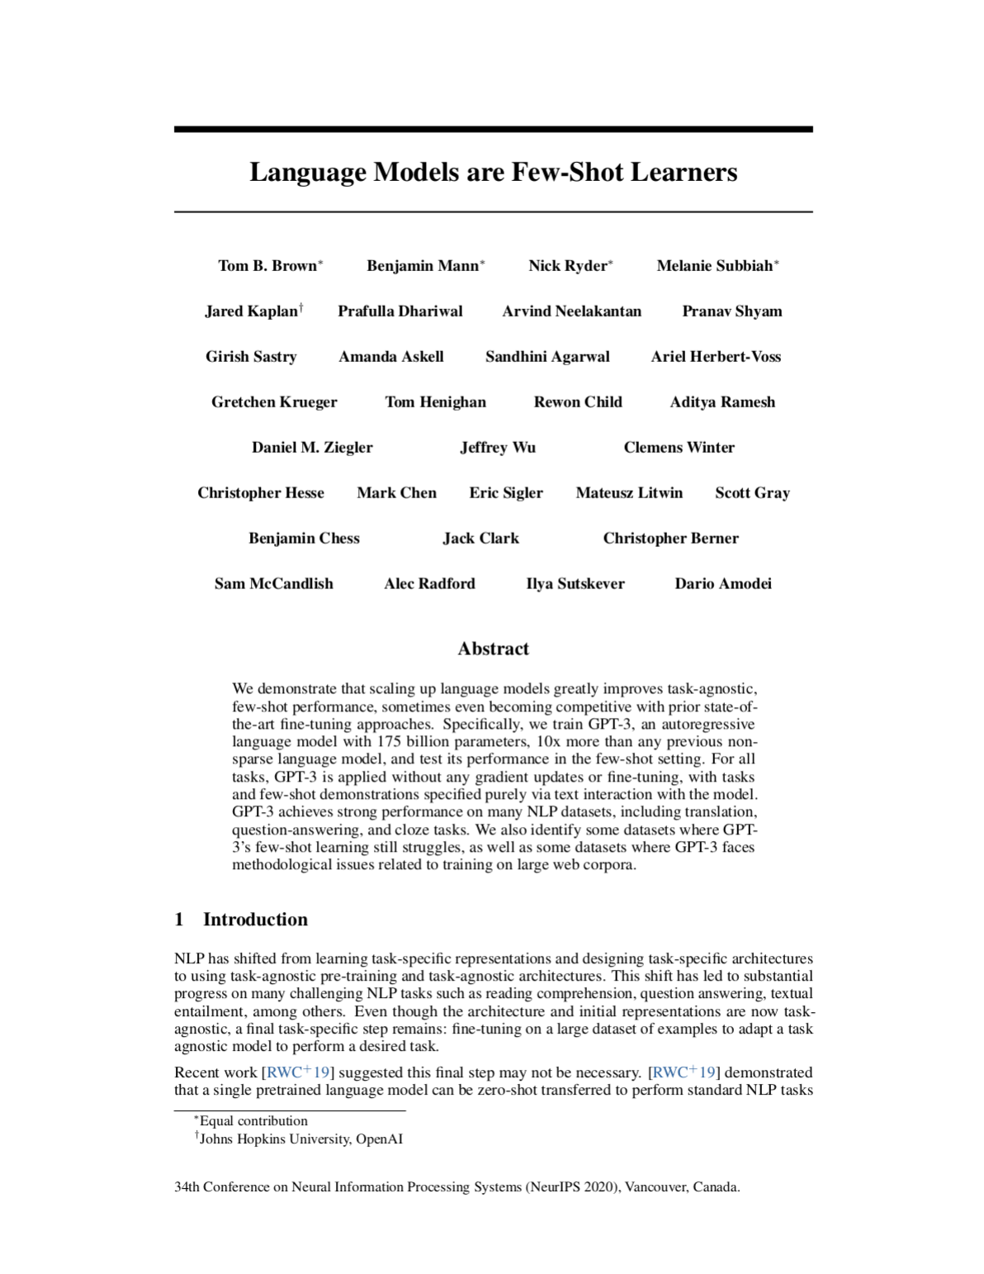
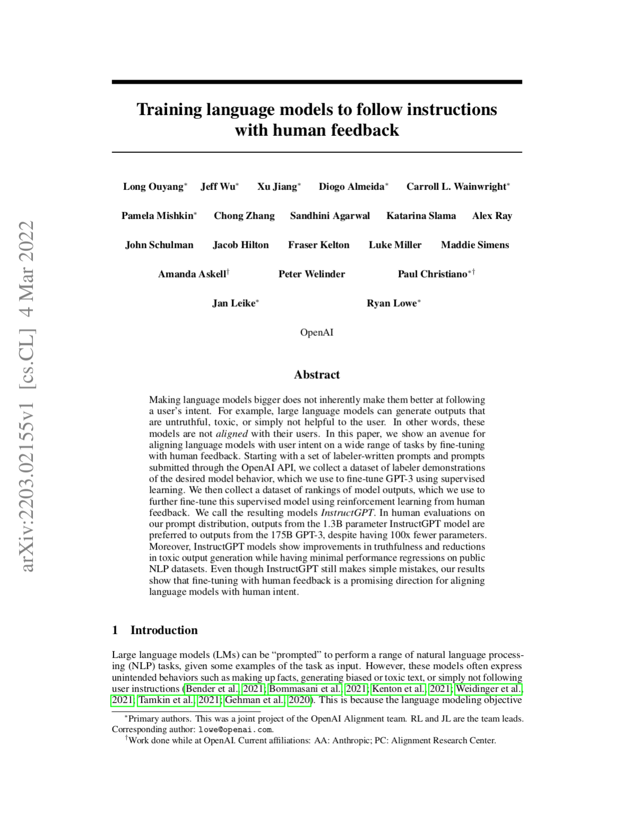
Module 1 Related Papers
Vaswani et al, 2017
The original Transformer paper
Devlin et al, 2018
BERT paper.
Self-supervised pretraining produces high utility embeddings
Brown et al, 2020
GPT-3 paper. Pre-training on enough data enables few-shot learning in LLMs
Ouyang et al, 2022
InstructGPT paper. Instructions can be encoded into training data and generalized.

Slide 27
Module 1 Additional Information
Karpathy videos:
The State of GPT
Backpropagation Lecture
Let's build GPT: from scratch, in code, spelled out.
Jay Alammar’s Blog:
The Illustrated Transformer
How GPT3 Works - Visualizations and Animations

Slide 28
Module 2 Preview
Chain of thought reasoning
Finetuning Mistral-7b and GPT-3.5
Parameter efficient techniques (Adapters, QLoRA)
Tokenizers
Make sure to do Quiz 1 by next Monday!

Slide 29
End of Module 1
Questions?

Slide 30
Embeddings
Why do we need to convert words to floating point vectors?

Slide 31
Embeddings
Vocabulary
0: Burrito
1: Racecar
2: Tree
3: Panda
Which word is halfway between Racecar and Tree?
Burrito
Tree
Panda
Racecar

Slide 32
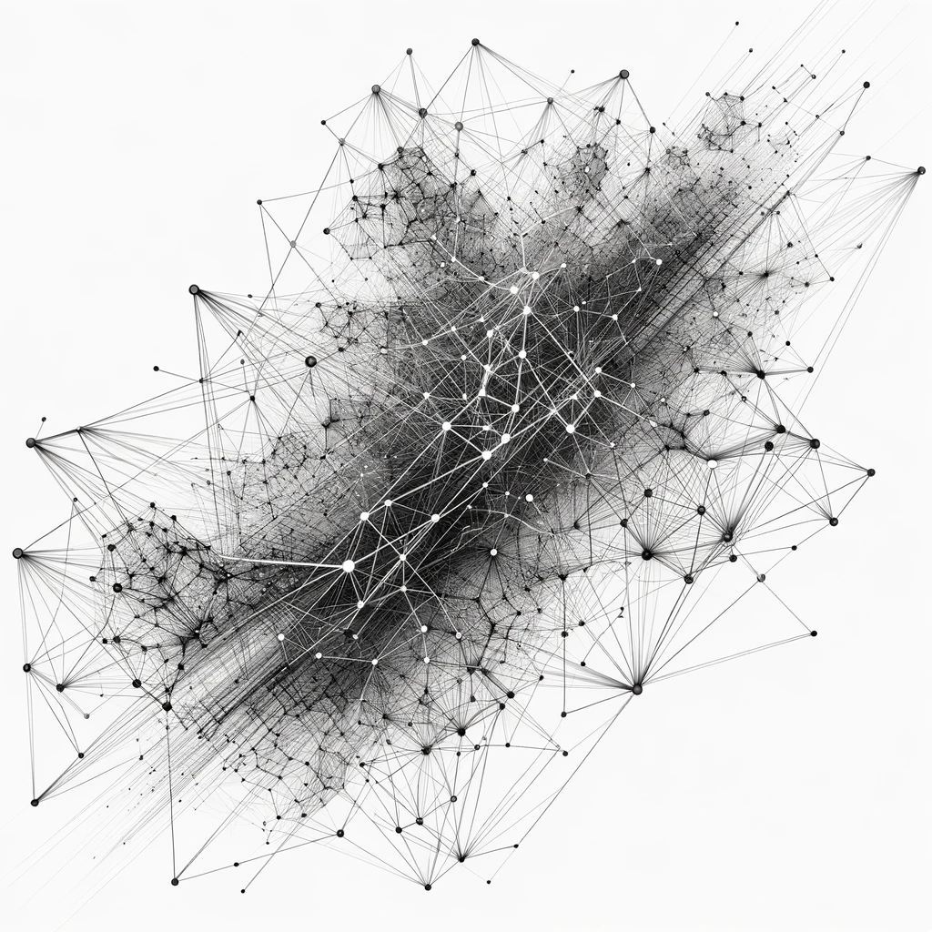
Embeddings
Tree
Natural language is discrete, making it difficult to determine the relationship between two structures.
Using co-occurrence, we can map them to continuous space.
Racecar

Slide 33
Embeddings
In practice, tokens are smaller than words
Byte-Pair [Link]
Word Piece
Many others

Slide 34
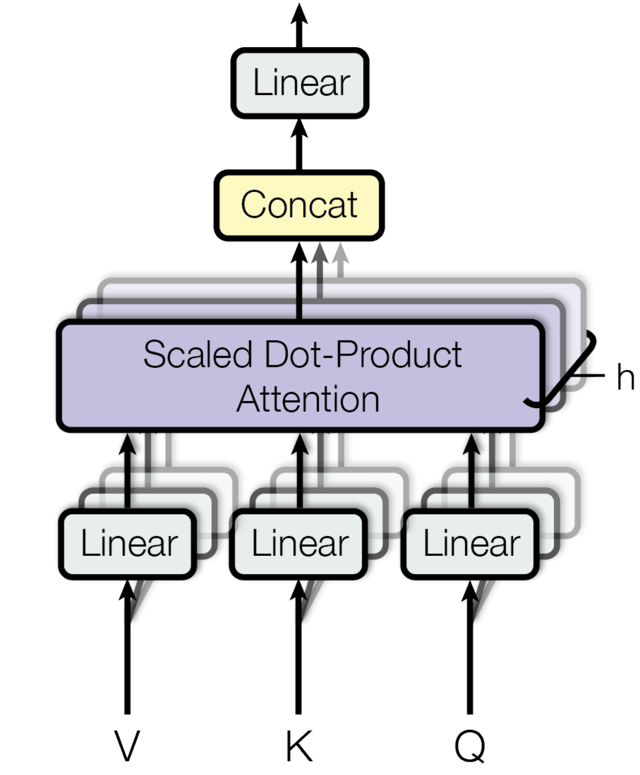
Self-Attention Explained
The “Multi-head Self Attention” mechanism enables a transformer to examine a token by attending to the tokens surrounding it.
Two types:
Causal self-attention (decoders)
Bidirectional self-attention (encoders)

Slide 35
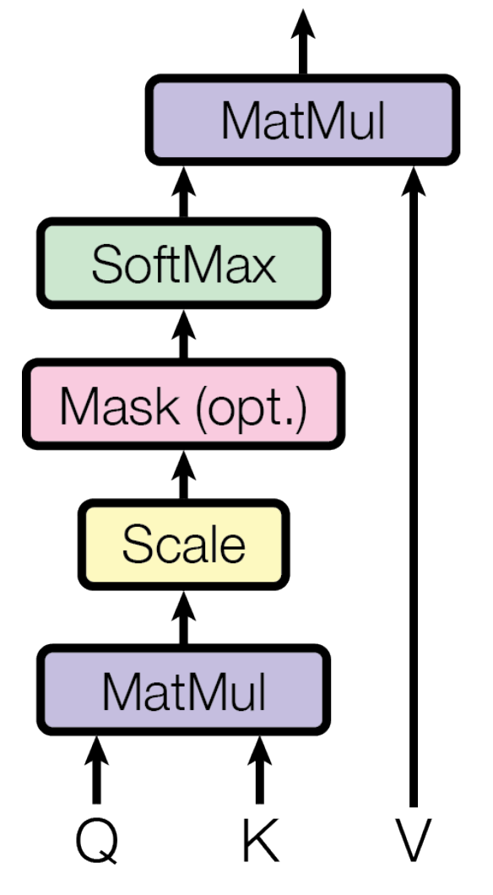
Self-Attention Explained
“Scaled dot product attention” is where each token is attended to by each other token through a series of matrix multiplications.

Slide 36
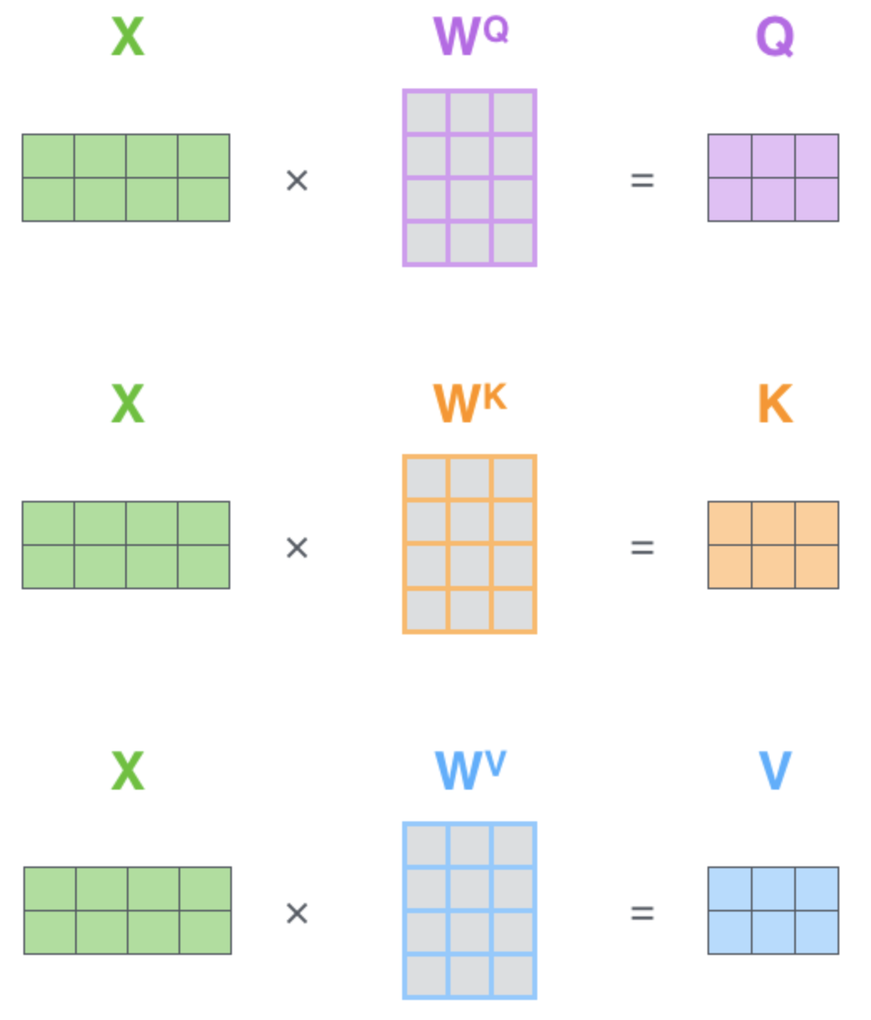
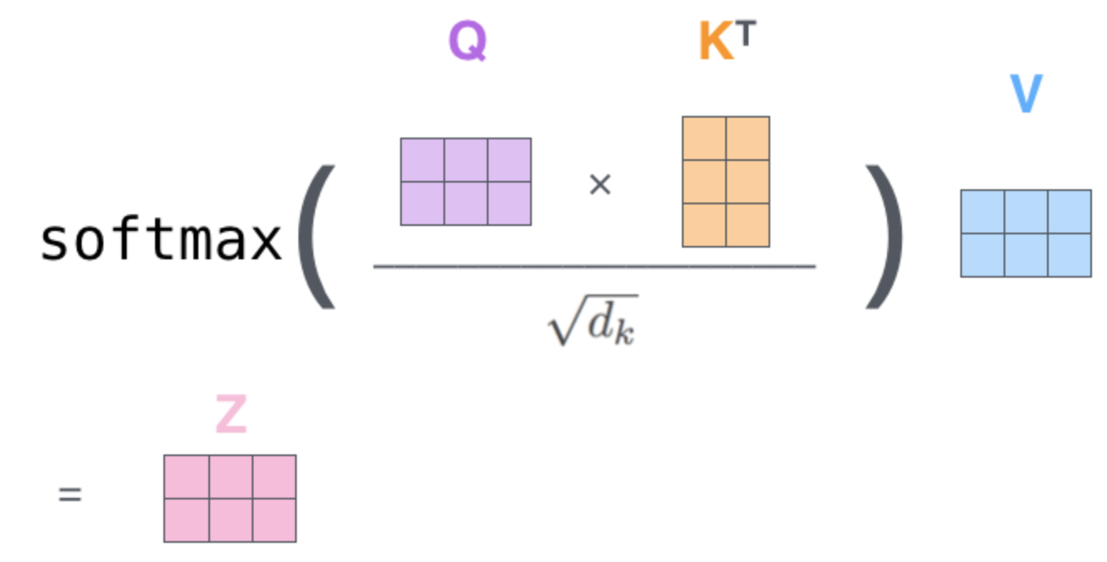
Self-Attention Explained
Self-attention as a series of matrix operations
Our token embeddings are multiplied by 3 weight matrices: W^{Q}, W^{K} and W^{V}
Source: The Illustrated Transformer

Slide 37
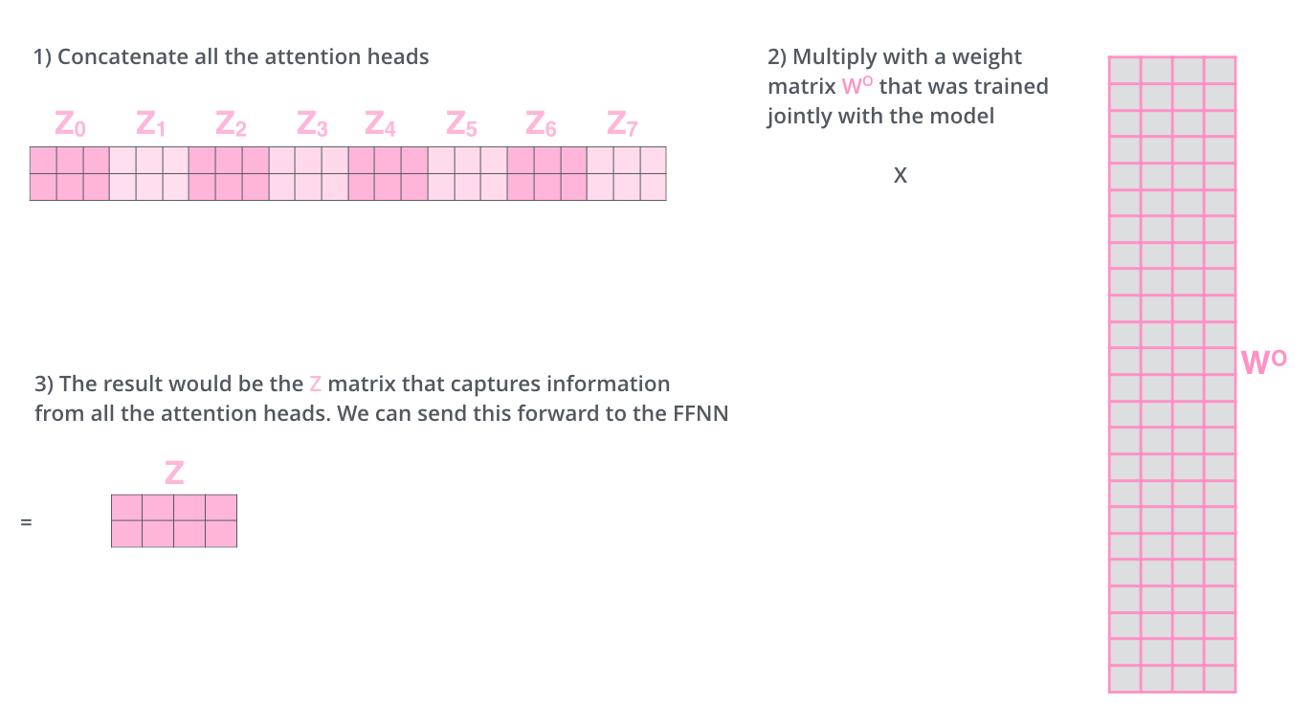
Self-Attention Explained
Source: The Illustrated Transformer

Slide 38
End of Module 1 Extra Contents
Questions?

